Slide 1



Recommender System
User’s review Amazon products

Slide 2




Recommender System - Our Team
“A” Team
Antonio
Brenda
Evaristo
Joan

Slide 3




Recommender System - 1. Motivation
Improve user experience: help users to discover new products and services based on their own interests.
User engagement: encourage users to engage with the content based on the recommendation of the products or services.
User loyalty: encourage customers to return.
Marketing campaigns: knowing the users preferences, is better to target marketing action.
Notes:
Objective to unlock the maximum potential of customers purchases
This impact businesses or e-commerce by for example…

Slide 4
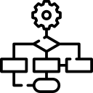







Recommender System - 2. Goals
Baseline
More complex data
More complex model
TBD: ethic recom, last seen …
Notes:
Recommend a product to one user
Try to apply other models to the dataset
Collaborative - Implicit (review=1, no_review=0)
NFM - Neural Factorization Machine
DeepFM - Deep Factorization Machine
xDeepFM -
WD - Wide&Deep
IPNN
DeepCrossNet
Establish a baseline model (MF model), based on interactions.
Add more explainable variables and do not use only interactions.
Use more complex models (beat the baseline).
To be defined: Study biases in recommendations/ recommend based on last seen etc.

Slide 5
Recommender System - Dataset - Categories
29 categories
Amazon Fashion
All Beauty
Appliances
Arts
Crafts and Sewing
Automotive
Books
CDs and Vinyl
Cell Phones and Accessories
Clothing
Shoes and Jewelry
Digital Music
Electronics
Gift Cards
Grocery and Gourmet Food
Home and Kitchen
Industrial and Scientific
Kindle Store
Luxury Beauty
Magazine Subscriptions
Movies and TV
Musical Instruments
Office Products
Patio
Lawn and Garden
Pet Supplies Prime Pantry
Software
Sports and Outdoors
Tools and Home Improvement
Toys and Games
and Video Games

Slide 6
Recommender System - Dataset - Our Category
Subset: Musical Instruments
Reviews
1,512,530
Products
112,222
Users
903,330
795,6
Mb
Notes:
ampliar un poco aqui a detalle de tipo de producto

Slide 7
Recommender System - 3. Implementation
DATASET
ANALYSIS
Amazon reviews (Recommender Systems Datasets (ucsd.edu)
One dataset for every product category
Common format: userId, itemId, rating, timespan
Get a script to set up category datasets:
Reformat data types
Eliminate duplicates
Reduce size by parametrization of minimum ratings: per item and user

Slide 8
Recommender System - 3. Implementation
COMPUTATIONAL RESOURCES
GIT repository (recommender system project AIDL2023)
colab notebooks
Google cloud virtual machine
DEEP LEARNING MODELS
Factorization Machines (FM)
Graph Convolutional Embeddings
Random
Popularity-Based

Slide 9
Recommender System - 4. Milestones

Slide 10
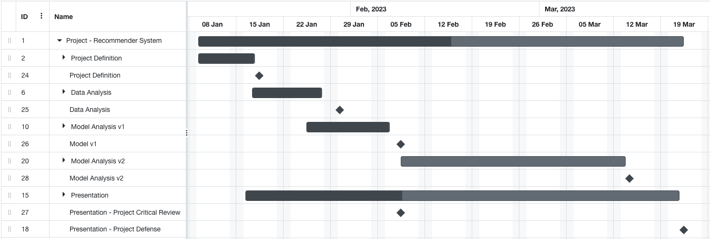
Recommender System - 5. Project plan
18/01
30/01
08/02
14/03
08/02
22/03

Slide 11
Recommender System - 5. Project plan

Slide 12
Recommender System - 6. Progress

Slide 13
Recommender System - 7. Our questions
Is it relevant to apply the model to other datasets?
Based on your experience, which metrics could we use for bias detections?

Slide 14
Recommender System - Dataset - Content
Reviews: ratings, text, helpfulness votes.
Product: descriptions, category information, price, brand, image features, color (white or black), size (large or small), package type (hardcover or electronics), bullet-point descriptions under product title, technical details table (attribute-value pairs) and similar products table.
Links: also viewed/also bought graphs.

Slide 15
Recommender System - 3. Implementation
DATASET
USE
Reduced Dataset while analyzing models with minimum ratings per item and user of 6
Selected model training we will use dataset with minimum ratings per item and user of 3

Slide 16
Recommender System - Dataset - Analysis: quality
Subset: Musical Instruments
Users
Reviews > 3 Products Reviews > 3
User
88.135
Product
26.641
Reviews
461.254
Clean file
23,7 Mb

Slide 17
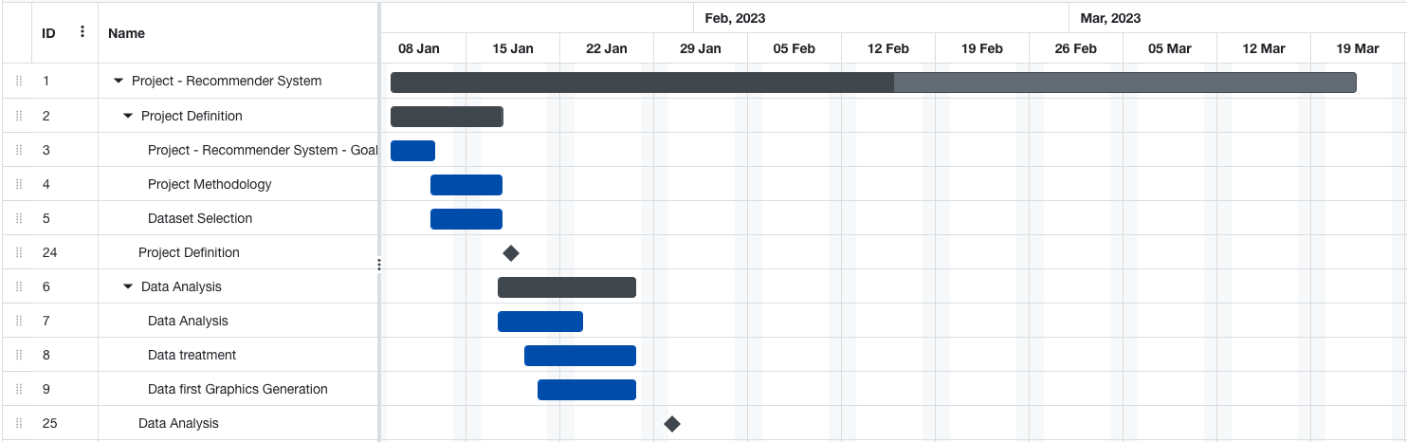
Recommender System - 5. Project Plan
18/01
30/01

Slide 18
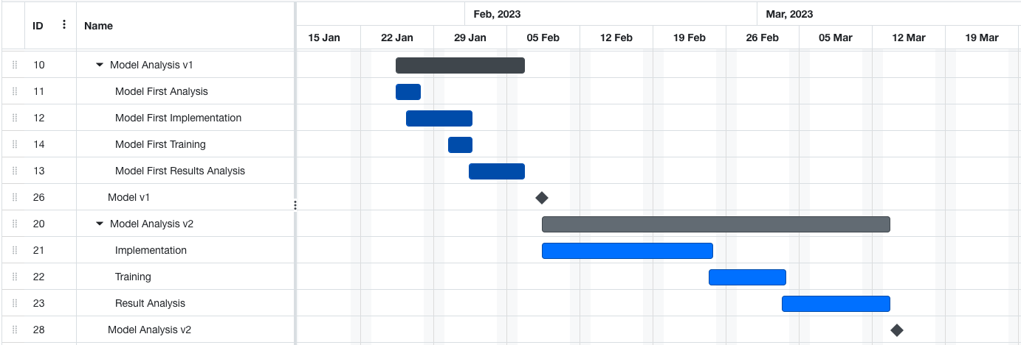
Recommender System - 5. Project Plan
08/02
14/03

Slide 19
Recommender System
Thank you! Questions?

Slide 20
Recommender System - Dataset - Time
Total reviews
233.1 million
Current data
reviews
05/1996 10/2018
(34gb)
Released
2014
Updates
05/2021
08/2020
Jianmo Ni Github

Slide 21


Recommender System - Motivation
Collaborative
Collaborative
Content-based
Demographic based
Utility based
Knowledge based
Popularity
Classification
Hybrid
Most widely implemented
Most mature technologies
Recognize similarities between users basis on their ratings
User, product and rating

Slide 22
Recommender System - Dataset - Analysis
Dataset
quality
User
Product
Reviews

Slide 23
Recommender System - Dataset - Analysis: User
User:
User-User interaction?
User purchase data?
User loyalty (bought again)?
Average rating per user
User with the highest rating
Graph of the user with the highest rating over time
User with less rating
Rating activity over time
Simple demographic info for the users (age, gender, occupation, zip)

Slide 24
Recommender System - Dataset - Analysis: product
Product:
Product-Product interaction?
Rating per product
Average rating per product
Top 10 most valued product
Graph of the most valued product over time
Most purchased product
Graph of the most purchased product over time
Least purchased product
Best valued product vs most purchased
Vendor reliability
Product availability

Slide 25
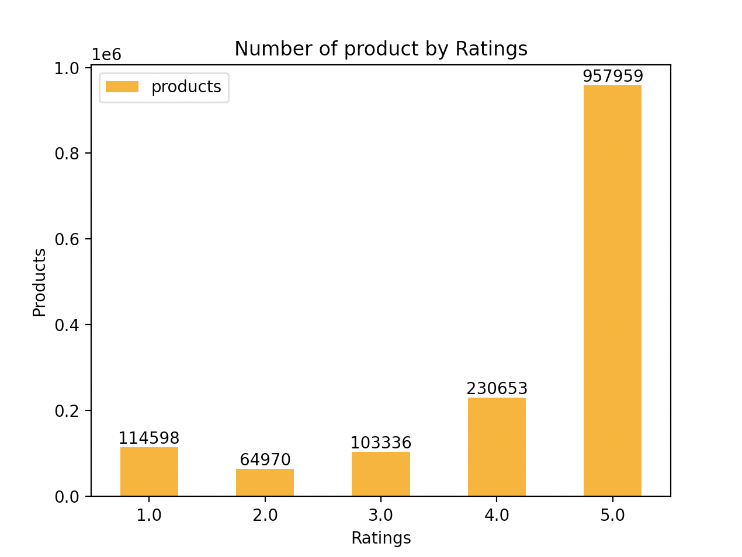
Recommender System - Dataset - Analysis: product

Slide 26
Recommender System - Progress
Which model is better?
How much time takes to train each model?

Slide 27
Recommender System - Our recommendation
Recommend
To user
Most popular products
Products based on user profile
Products based on users with similar profiles (Collaborative system)
Similar products based on user’s purchases historic (Content-based)
Top rating “5” user’s group: recommend similar products
Predict if user will like a product (Classification)
To Providers
Products to the right users

Slide 28
Recommender System - Training
Training 70% Test 30%
Training 1,058,771 Test 453,759
text

Slide 29
Recommender System - Evaluation of the system
Hit Ratio (HR@K)
Normalized Discounted Cumulative Gain (NDCG@K)
Mean Absolute Error (MAE)
Root mean squared error (RMSE)
Offline Experiments
Cross-validation

Slide 30
Recommender System - UPC Evaluation
Advisor (30%) - per student
○ Mid-project (15%)
○ Final (15%)
Presentation (30%) - per student
○ Communication skills (10%) - per student
○ Technical quality (20%) - per team (weighted by peers)
Report (40%) - per team (weighted by peers)

